Slide 1
Linked Data
Hands On - SPARQL
Fernando Aguilar Gómez
CSIC (+SKILLS4EOSC fellowship)

Slide 2
SPARQL
Recursive acronym: SPARQL Protocol and RDF Query Language
Standardized language for querying RDF graphs.
Standardized by the RDF Data Access Working Group (DAWG) of the World Wide Web Consortium (W3C).
Like SQL, query language. A search engine and data warehousing are required.
SQL (Language) - MySQL (Engine)
SPARQL (Language) - Virtuoso (Engine)
http://vos.openlinksw.com/owiki/wiki/VOS/VOSSparqlProtocol
Results can be sets (tables) or RDF networks.

Slide 3
Tips for queries
To understand what an ontology is
To know the existing relationships
To know the schemas used
Distinguish between the data itself and the classes.
Search classes and instances to know the relationships of an object

Slide 4
Basic Query
PREFIX – Namespaces
SELECT – Attributes you want to query and get as response
WHERE – Conditions to fulfil

Slide 5
Basic Query - Example 1
List of Films in DBpedia
PREFIX – Namespaces
SELECT – Attributes you want to get
WHERE – Conditions to fulfil
PREFIX dbo: <http://dbpedia.org/ontology/>
PREFIX foaf: <http://xmlns.com/foaf/0.1/>
SELECT ?film
WHERE{
?film a dbo:Film .
} LIMIT 100
a = rdf:type

Slide 6
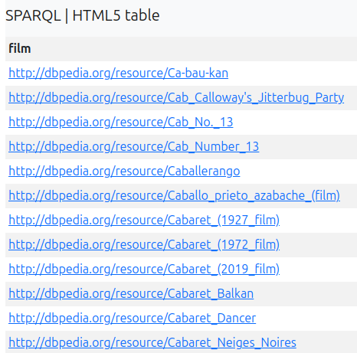
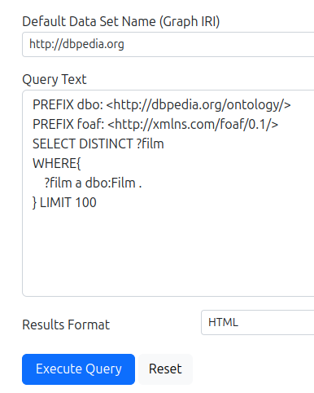
Basic Query - DBpedia endpoint
List of Films in DBpedia
https://dbpedia.org/sparql
URIs… Names?

Slide 7
Basic Query - Example 2
List of Films in DBpedia
PREFIX – Namespaces
SELECT – Attributes you want to get
WHERE – Conditions to fulfil
PREFIX dbo: <http://dbpedia.org/ontology/>
PREFIX foaf: <http://xmlns.com/foaf/0.1/>
SELECT ?title
WHERE{
?film a dbo:Film .
?film foaf:name ?title
} LIMIT 100
a = rdf:type

Slide 8
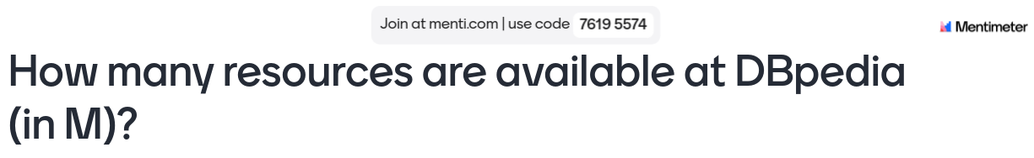

Slide 9
Basic Query - Example 3
Director per film
PREFIX dbo: <http://dbpedia.org/ontology/>
PREFIX foaf: <http://xmlns.com/foaf/0.1/>
SELECT DISTINCT ?director
WHERE{
?film a dbo:Film .
?film dbo:director ?director .
} LIMIT 100

Slide 10
Basic Query - Example 4
Birthdate of directors
PREFIX dbo: <http://dbpedia.org/ontology/>
PREFIX foaf: <http://xmlns.com/foaf/0.1/>
SELECT DISTINCT ?director ?bd
WHERE{
?film a dbo:Film .
?film dbo:director ?director .
?director dbo:birthDate ?bd .
} LIMIT 100

Slide 11
Basic Query - Example 5
Birth place of directors
PREFIX dbo: <http://dbpedia.org/ontology/>
PREFIX foaf: <http://xmlns.com/foaf/0.1/>
SELECT DISTINCT ?director ?bp
WHERE{
?film a dbo:Film .
?film dbo:director ?director .
?director dbo:birthPlace ?bp .
} LIMIT 100

Slide 12
Basic Query - Example 6
Birth place of directors. FILTER: only cities < 10000 inhabitants
PREFIX dbo: <http://dbpedia.org/ontology/>
PREFIX foaf: <http://xmlns.com/foaf/0.1/>
SELECT DISTINCT ?director ?bp
WHERE{
?film a dbo:Film .
?film dbo:director ?director .
?director dbo:birthPlace ?bp .
?bp dbo:populationTotal ?population .
FILTER (?population < 10000)
} LIMIT 100

Slide 13
Basic Query - Example 7
Birth place of directors. FILTER: only cities < 10000 inhabitants
Birthdate: What I missed?
PREFIX dbo: <http://dbpedia.org/ontology/>
PREFIX foaf: <http://xmlns.com/foaf/0.1/>
SELECT DISTINCT ?director ?bp
WHERE{
?film a dbo:Film .
?film dbo:director ?director .
?director dbo:birthPlace ?bp .
?bp dbo:populationTotal ?population .
FILTER (?population < 10000)
} LIMIT 100

Slide 14
Thank you! Questions?
Fernando Aguilar Gómez
f.a [at] CSIC.es
To cite this presentation, please copy and paste: <Surname, Name. (Date). Pres title, occasion of the presentation. Link to presentation in Skills4EOSC community on Zenodo>

